Slide 1
Handling Texts in Python
Output Formatting
Pattern Matching & Parsing
Reading & Writing from/to Files
Reading from the Internet

Slide 2
Output Formatting
So far we’ve seen two ways to output values
Writing an expression to the interpreter
Using the print() function
Built-in objects implement __str__() to print nicely
We can do the same in our classes
print(obj1,obj2,..) will print the objects separated by spaces
Often we need more control over the formatting
One option is to handle all strings ourselves
Slicing, concatenation & some useful padding operations
Another option is to use the str.format() method

Slide 3

Converting Values to Strings
Python has 2 functions to convert values to strings:
str() returns a human-readable representation
repr() returns an interpreter-readable representation
It raises SyntaxError if there is no such representation
For objects with no human-readable representation, str() returns the same value as repr()
For many objects (like numbers, lists, dictionaries) the representation is the same
For strings it is different:

Slide 4
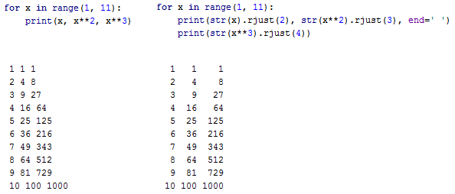
Padding

Slide 5
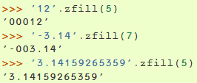
Padding (2)
str.rjust(x) aligns the output to the right giving it x characters, and pads with spaces to the left
Other similar methods: str.ljust(), str.center()
Another useful method is zfill() which pads numeric strings with trailing zeros
Notes:
נקודה נחשבת כתו!, למשל:
3.14- נספרים 5 תוים + 2תוים הם אפסים מובילים.

Slide 6


The format() Method
The format() method uses curly brackets & format fields
A number in the brackets refers to the object’s position
We can use keywords in the brackets instead of numbers

Slide 7
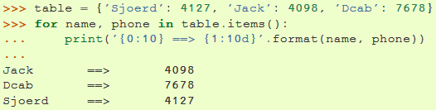
The format() Method (2)
We can add ':' + format specifier to control the format
An integer after the ':' causes the field to be a minimum number of characters wide
This is useful for aligning tables nicely

Slide 8

The format() Method (3)
Instead of specifying multiple format fields, we can use a dictionary as a single field
We’ll use the keys to access the dictionary’s values
This could also be done by passing the table as keyword arguments with the ‘**’ notation

Slide 9

The format() Method (4)
An alternative to format() is the operator % which is similar to the functionality of printf()

Slide 10
Some Useful String Methods
find(sub[, start[, end]]): returns the first index of sub in the string, -1 if not found
isdigit(): returns True if the string composed of digits
split(), join(): We already met those
replace(old, new[, count]): returns a copy of the string with all occurrences of substring old replaced by new
splitlines(): returns a list of the lines in the string
startswith(prefix)
endswith(suffix)

Slide 11
Formatting Exercise
Write a function DatesPrinter() that gets a list of tuples containing 3 numbers (day, month, year). You can assume the numbers are valid.
Your task is to print a table that each row represents
a date from the list.
The table will have 4 columns – each representing a different date format:
padding (dd/mm/yyyy)
non padding (d[d]/m[m]/yyyy)
14 JUN 01 (dd <3-letters-month> <2-digit-year>
7 August 2015 (d[d] <full-month-name> <4-digit-year>

Slide 12
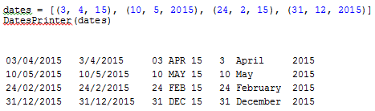
Formatting Exercise – cont’
Whenever there are spaces you should align to the left according to the string
There should be exactly 3 spaces between columns (according to the longest string on the left column)

Slide 13
Pattern Matching
A Regular Expression (or RE) specifies a pattern that matches a set of strings
the functions in module re (import re is needed) let you check if a particular string matches a given regular expression, some functions in module re are:

Slide 14
Pattern Matching
re.fullmatch(pattern, string): returns a match-object if pattern matches string, None otherwise
re.match(pattern, string): looks for pattern in the beginning of string and returns a match-object or None
re.search(pattern, string): finds the first occurrence of pattern in string and returns a match-object or None
re.findall(pattern ,string): returns all non-overlapping matches of pattern in string, as a list of strings
re.finditer(pattern,string): same as re.findall(), returns all non-overlapping matches of pattern in string, but returns them as an iterator

Slide 15
Defining REs
Regular expressions contain special and ordinary chars
Chars like 'A', 'a', or ‘6' simply match themselves
You can concatenate ordinary chars, abc matches ‘abc‘
Some chars, like |, ( or \ are special
'\' is the escape character:
\d does not mean the char '\' followed by the char 'd'
\d matches any digit char , equivalent [0-9]
\D matches any char that is not a digit,
equivalent[^0-9]
\w : matches Unicode word chars (digits, letters, '_'),
equivalent [a-zA-Z0-9_]
. : matches any char except new line

Slide 16
Some Basic Samples
\d\d \D\D\D matches 22 aaa, 34 BC* or 60 G$G
\w\w\w-\w\w\w matches abc-def, ABC-321, a_b-2G6
\d\d.\d\d\d is not like %2.3f
It matches 23.456 but also 23h456, 238456 and 23(456
This is because . is a special char that matches any char
If we want it to be exactly ‘.’ we add the escape char \
\d\d\.\d\d\d matches only numbers like %2.3f
Notes:
%2.3f - הכוונה למספרים בתבנית/צורה הזו!

Slide 17
More on Escape Chars
Suppose we want to match a date format dd\mm\yyyy
We need to match the char \ which is the escape char
A suitable pattern would be \d\d\\\d\d\\\d\d\d\d
\ is also the escape char for the Python interpreter
This is how it recognizes \n and \t for example
So actually to escape \ we need \\\\
To avoid the collision with the interpreter we use r” ”:
r“\n” matches \ and n as two regular chars
We can use r”RE” on every regular expression
This is not a must for every RE, but a good habit
Notes:
import re s = r"Silvester the cat eats spam on the: 05\06\2017 and Boxer the dog eats dogly on the: 09\12\2006" p = re.compile(r"(\d\d\\\d\d\\\d\d\d\d)+") m = p.findall(s) for match in m: print(match)

Slide 18
Special Chars for Multiplicity
? : matches 0 or 1 repetitions of the previous RE
ab? matches a or ab
* : matches 0 or more repetitions of the previous RE
ab* matches a, ab, or a followed by any number of bs
+ : matches 1 or more repetitions of the previous RE
ab+ matches ab, or a followed by any number of bs
{m} : Exactly m chars of the previous RE are matched
ab{5} matches abbbbb
{m,n} : m to n repetitions of the previous RE

Slide 19
Special Chars for Choice
[ ] defines a set of chars and matches one of them
[amk] matches a, m or k
[0-9a-zA-Z] matches an alpha-numeric char (g, 1, H)
A|B : matches A or B (A and B are REs)
Hello|Hi matches one of those words
Hello*|Hi* matches Hellooo, Hellooooo, and Hiiiiiiiii

Slide 20
Grouping REs
(RE): specifies a group of chars corresponding to RE
It can be combined with multiplicity chars
(\d\D)?-(\D\d)* matches 2a-b4, 2a-t5y6u7i8, -t5j6, -
re.fullmatch(), re.match() and re.search() return a match-object
We can access groups with match’s method group()
group(n): splits the match to subgroups (each is a string)
For n=0 it returns the entire matching string
In 2a-b4: group(0) = 2a-b4, group(1) = 2a,
group(2) = b4

Slide 21
Grouping REs
groups(): returns a tuple of all the subgroups
For RE with groups, re.findall() returns a list of tuples matching the groups in RE.
Use re.finditer() to iterate through complete matches

Slide 22
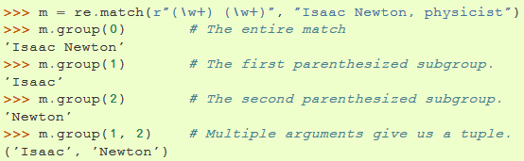

Regular Expression Examples
If a group matches multiple times, only the last match is accessible

Slide 23
Pattern Matching Exercises
Write a function that gets a sentence (string) and returns a list of the numbers (integers or floats) in the string. Do the exercise twice – once with re.findall() and once with re.finditer().
Remember that re.findall() returns a list of matches of the groups if your expression contains groups.
For 1 group it returns a list of strings matching that group
For more than 1 group it returns a list of tuples of strings matching those groups.
Notes:
כולל מציאת שליליים והדפסתם עם הסימן מינוס.

Slide 24
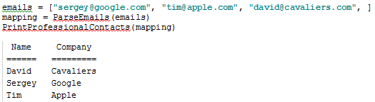
Pattern Matching Exercises (2)
Write a function ParseEmails() that gets a list of emails in the form name@company.com, where name and company can only contain alphanumeric characters and underscore. The function will return a mapping of the names to their corresponding companies.
Then write another function PrintProfessionalContacts() that will get the mapping and will print a table of the names and companies, nicely aligned to the left. Keep 3 spaces between the columns, make the first letters of names and companies capitalized, and add a title aligned to the center with a title line. Here is a sample output:
Notes:
http://pythoncentral.io/how-to-sort-a-list-tuple-or-object-with-sorted-in-python/

Slide 25
Opening Files
open(filename,mode) returns a file object
Modes can be:
r: only for reading
w: only for writing (an existing file will be replaced)
a: data will be appended at the end of the file
r+: both reading and writing
Omitted: r is assumed
b: When appended, the file is opened in binary mode

Slide 26

Reading & Writing Files
f.read(size) reads size bytes of f and returns a string
If size is omitted it reads the entire file
It’s your problem if the size is twice your PC’s memory!!
read() remembers the current location
If you read past the EOF an empty string is returned

Slide 27
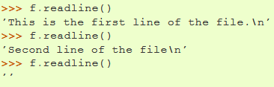

Reading & Writing Files (2)
f.readline() reads a single line from the file
It returns a string containing the line with a “\n”, except for the last line of the file
If the file ends in a newline, then the last string is empty
Looping the lines of a file is simple & memory efficient
Why do we use end= ' ' here?
00

Slide 28
Reading & Writing Files (3)
We can also read the lines of f into a list using f.readlines() or simply list(f)
Isn’t it the simplest way to read a file you’ve ever seen?
f.write(string) writes string to the file, returning the number of characters written
In order to write non-string values, first convert them to strings (using str(), repr(), format(), etc.)
f.tell() returns the current position, f.seek() changes it

Slide 29


Properly Freeing Resources
f.close() closes the file and frees up system resources
Some objects define standard clean-up actions when the object is no longer needed
They will also run in case of an exception raised
This is done using the with keyword
File objects implement such clean-up actions
The following code: can raise an exception and we might forget to close()
Better use this:
It closes - f
It’s shorter then the equivalent try-finally blocks

Slide 30
Internet Access
There are a number of modules for accessing the Internet and processing Internet protocols
Two of the simplest are urllib.request for retrieving web data and smtplib for sending mail
Replace <url> with any URL
Let’s play with an online world time server
from urllib.request import urlopen with urlopen('<url>') as response: for line in response: line = line.decode('utf-8') #Decoding binary data to text print(line, end=' ')

Slide 31
Internet & Parsing
Python is very good for handling texts and parsing – why not use it for the Internet?
With urllib we can interact with webservers
We can parse & analyze the responses
This is what web crawlers do
Google’s search engine crawlers are written in Python
The html.parser module helps us parse html code
The standard library is full of useful Internet modules: XML, AJAX (XML-RPC), JSON, FTP & many more
Notes:
https://en.wikipedia.org/wiki/Web_crawler

Slide 32
Files & Internet Exercises
Write a program that will calculate the average word length of a text stored in a file and will print it with 2 decimal points.
Use the text of this exercise's instructions as input.
Don't forget to ignore punctuations marks and line endings.
Write a program that given a text file will create a new text file containing all the lines from the original file in reversed order.
The lines should also be numbered
Use the text of this exercise's instructions as the input

Slide 33
Files & Internet Exercises (2)
Gorge, George and Gregory noticed that their names start with a 'g' and contain 5-7 letters. They made a bet about the number of English words that correspond to those 2 conditions. Write a program that accesses http://www.puzzlers.org/pub/wordlists/unixdict.txt, finds all those words and save them to a file, each in a single line.

